Slide 1
Fix your SQL database design with T-SQL static code analysis
@ErikEJ

Slide 2
Challenges?
Runtime errors in database due to uncaught syntax errors
No standard approach to naming or other database design ”business rules”
No qualified review of schema design
Feedback on schema design issues late in the process
No cross platform build and deployment support
No proper NuGet integration (.dacpac files, rules)

Slide 3
Process
Create / import .sql scripts
Build & Analyze
.dacpac
Deploy
Create SQL project
DacFX

Slide 4
Demo!

Slide 5
sqlpackage
DacFx
TransactSql.ScriptDom
SqlClient

Slide 6
Demo!

Slide 7

CTA
Add you database schema to source control
Enable code analysis locally and in CI
Optional: Create your own rules and contribute them back to the community

Slide 8
Classic .sqlproj vs MSBuild.SDK.SqlProj
 | .SQLPROJ (Legacy VS) | MSBuild.SDK.SqlProj
Create, build, publish a .dacpac | ✔ | ✔
Run Code Analysis | ✔ 15 rules | ✔ 140+ rules
Run custom rules | ✔ admin only | ✔
Run rules on hosted agent | ✔ | ✔
Run custom rules on hosted agent | ❌ | ✔
Build on Linux (dotnet build) | ❌ | ✔
Visual designers/Schema compare | ✔ | ❌
NuGet pack (.dacpac/rules) | ❌ | ✔
SQL CLR | ✔ | ❌ (workaround)

Slide 9
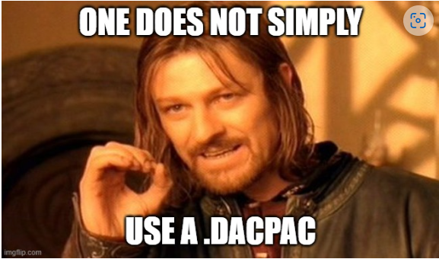
Q & A

Slide 10
Q & A
Handling destructive schema changes?
How do I ”seed data” to my database using a .dacpac?
This is a community project, what is MS doing?
I use Postgres / Oracle /MySQL – can I use this?
Does it work on Azure SQL Databases?
What if I just want to analyze a script on disk?

Slide 11
Q & A
Sharing parts of a database (f.ex. monitoring) ?
What if my db has dependencies on other database?
How would this work with EF Core?
How about .NET Aspire?

Slide 12
What is a dacpac and why should I care?

Slide 13
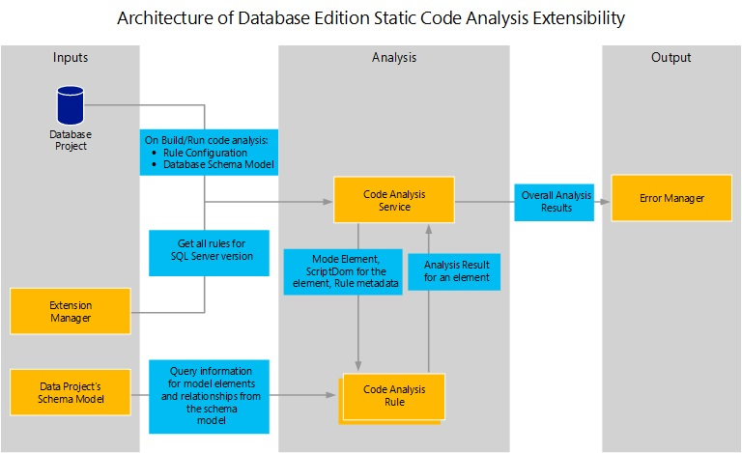

Slide 14
Why?
Data Tier Application Package
Get your database under source control
Ensure your .sql scripts ”build” – code validation
Ensure your .sql scripts follow business rules – code analysis
Deploy changes to the database schema with changes to your app
No more migration scripts – simply describe your desired state
Cross platform build and deployment support

Slide 15

Process
Create .sql scripts
Build
.dacpac
Deploy
Create .sqlproj

Slide 16
Tooling
Create / import .sql scripts
Build & Analyze
.dacpac
Deploy
Create SQL project
Visual Studio
VS Code
sqlpackage extract
dotnet new
Azure DevOps pipelines
GitHub actions
sqlpackage publish
MSBuild
dotnet build
dotnet pack Analyzer rules
DacFX

Slide 17

Why .dacpac?
Ensure high quality and consistent SQL schema under source control
Enforce design, performance and security rules
Desired state configuration
Publish magic!

